Slide 1
Bayesian classification
review Bayesian statistics
derive K nearest neighbors (KNN) classifier
analysis of 2-way classification results
homework assignment
parametric Bayesian classification
homework assignment
connection to neural networks

Slide 2
Review: Bayes’ Rule for binary classification
prior
Class likelihood
posterior
normalization
Prior is information relevant to classifying that is independent
of attributes x
Class likelihood is probability that a member of class C will have
attribute x
Assign example with attributes x to class C if P(C|x) > 0.5
Notes:
Prior is what we know about credit risk before we observe a clients attributes; might be per-capita bankrupties
Class likelihood, p(x|C), probability of observing x conditioned on the event being in class C
given client is high-risk (C = 1) how likely is X = {x₁, x₂}
deduced by data on a set of known high-risk clients
Evidence, p(x), is essentially a normalization; also called “marginal probability” that x is seen regardless of class
Posterior, P(C|x), probability that client belongs to class C conditioned on attributes being X
When normalized by evidence, posteriors add up to 1

Slide 3
Review: Bayes’ Rule: K>2 Classes
Normalized priors
Notes:
Priors, likelihoods, posteriors, and margins are class specific
Evidence is sum of margins over classes

Slide 4
Derive K-nearest-neighbors (KNN)classification method

Slide 5
Bayes’ M>2 classifier based on K nearest neighbors
Consider data set with N examples, N_{i} of which belong to class i; P(C_{i}) = N_{i}
Given an example with attributes x, draw a hyper-sphere of volume V in attribute space, centered on x and containing precisely Κ other training examples (K nearest neighbors), irrespective of their class.
Suppose this sphere contains n_{i} examples from class i, then p(x|C_{i})P(C_{i}) = V⁻¹(n_{i}/N_{i})N_{i} = V⁻¹n_{i}
5
Notes:
Prior is what we know about credit risk before we observe a clients attributes; might be per-capita bankrupties
Class likelihood, p(x|C), probability of observing x conditioned on the event being in class C
given client is high-risk (C = 1) how likely is X = {x₁, x₂}
deduced by data on a set of known high-risk clients
Evidence, p(x), is essentially a normalization; also called “marginal probability” that x is seen regardless of class
Posterior, P(C|x), probability that client belongs to class C conditioned on attributes being X
When normalized by evidence, posteriors add up to 1

Slide 6
Bayes’ classifier based on K nearest neighbors
Using Bayes’ rule we find posteriors p(C_{k}|x) = n_{k}/Κ
Assign x to the class with highest posterior, which is the class
with the highest representation among the Κ training examples
in the hyper-sphere centered on x (i.e. among K nearest neighbors)
K=1 (nearest neighbor rule) assign x to the class of nearest
neighbor in the training data.
Lecture Notes for E Alpaydın 2010 Introduction to Machine Learning 2e © The MIT Press (V1.0)
6

Slide 7
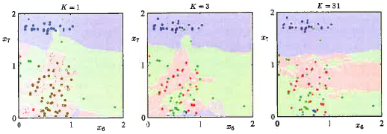
Bayes’ classifier based on Κ nearest neighbors (KNN)
Usually chose Κ from a range odd integers based on validation error
In 2D, we can visualize the classification by applying KNN to every point in the
(x₁,x₂) plane. As Κ increases expect fewer islands and smoother boundaries
Lecture Notes for E Alpaydın 2010 Introduction to Machine Learning 2e © The MIT Press (V1.0)
7

Slide 8
Analysis of binary classification results

Slide 9
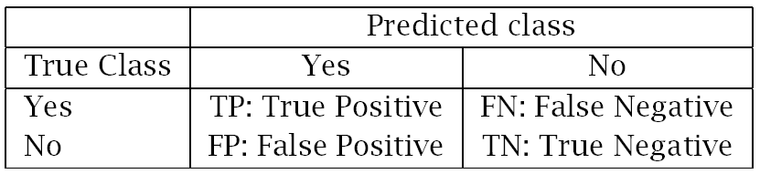
Quantities defined by binary confusion matrix
Let C1 be positive class, C2 be negative class, N be # of instances
Error rate = (FP+FN)/N = 1-accuracy
False positive rate = FP / (FP+TN) = fraction of C2 instances misclassified
Ture positive rate = TP / (TP+FN) = fraction of C1 instances correctly classified
9

Slide 10
Receiver operating characteristic (ROC) curve
Let C1 be positive class
Let θ be the threshold of P(C1|x) for assignment of x to C1
If θ is near 1, rare assignments to C1 have high probability of being correct
both FP-rate and TP-rate are small
As θ decreases both FP-rate and TP-rate increase
For every value of θ, (FP-rate, TP-rate) is point on the ROC curve
Objective: find value of θ such that TP-rate near 1 when FP-rate << 1
10

Slide 11
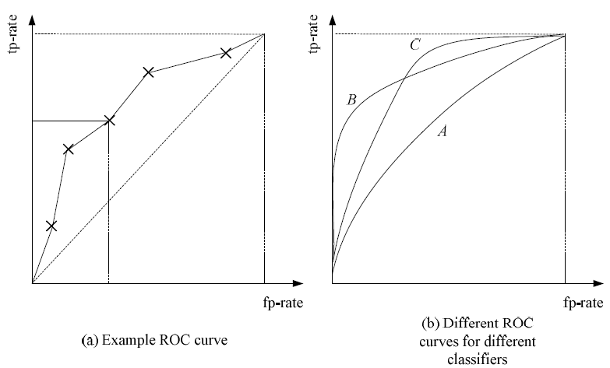
Examples of ROC curves
marginal success
Chance alone
11
Notes:
Ideal is TP-rate = 1 when FP-rate = 0 (upper-left courner)
Classify by chance alone, expect TP-rate = FP-rate (diagonal)
Shape of ROC curve provides a basis for comparing classifiers

Slide 12
Calculating smooth ROC curves
at selected θ-values, calculate FP-rate and TP-rate
call plot routine
Calculating digital ROC curves

Slide 13
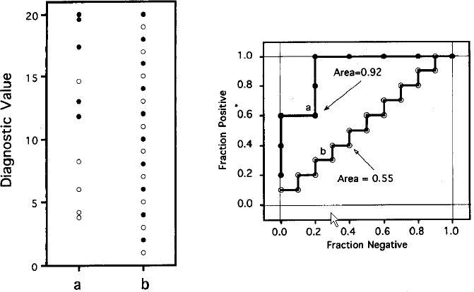
Digital ROC curves
Assume C1 is the positive class. Rank all examples by decreasing P(C1|x)
In decreasing rank order, move up 1/P(C1) for each positive example and move right 1/P(C2)
for each negative example
If all examples are correctly classified,
ROC curve will be in upper left.
Area under the ROC = 1
If P(C1|x) is not correlated with class
labels, ROC curve will be close to the
diagonal.
Area under the ROC ~ 0.5

Slide 14
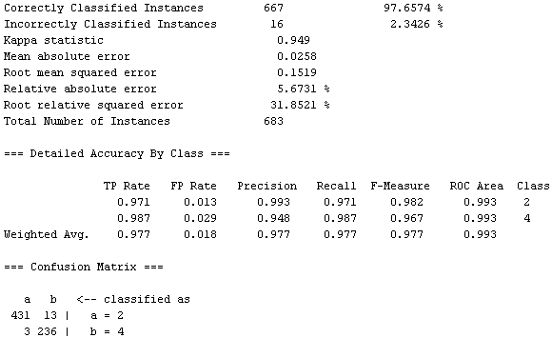
Confusion matrix and ROC statistics in WEKA output

Slide 15
Assignment 1: Due 8/30/16
Classification by K Nearest Neighbors (KNN) technique
Dataset on class web page from Golub et al, Science, 286 (1999) 531-537
Can 2 types of leukemia, AML and ALL, be distinguished by gene-expression data?
See class website for details

Slide 16
Parametric Bayesian classification:
assume a distribution function for class likelihoods, p(x|C_{i}) (Gaussian, for example)
estimate parameters of distribution from data
(by Maximum Likelihood Estimation, for example)
use relative class sizes in dataset for priors, p(C_{i})
assign examples to classes based on posteriors, p(C_{i}|x)
define a “discriminant” in attribute space (optional)

Slide 17
Maximum Likelihood Estimation (MLE)
Procedure to extract information from data for parametric classification
Find the value of parameters {θ } that maximize the probability that the dataset X was drawn from the assumed probability distribution
In simple cases, procedure is analytic
Example: mean and variance of Gaussian distribution
When analytical method is not possible, iterative method can be used (expectation-maximization)
17

Slide 18
Analytic MLE procedure
construct the likelihood of {θ } given the sample X
l(θ|X) = p (X |θ) = ∏_{t} p(x^{t}|θ)
Take the log to convert product to sum
L(θ|X) = log(l(θ|X)) = ∑_{t} log p(x^{t}|θ)
Fine the values of {θ } that maximizes L(θ|X)
18

Slide 19
Simple Example: Bernoulli distribution of Boolean variables
x = {0,1}
x = 0 implies failure
x = 1 implies success
p_{o} = probability of success:
parameter to be determined from data
p(x) = p_{o}^{x} (1 – p_{o} ) ^{(1 – x)}
p(1) = p_{o} p(0)= 1 – p_{o}
p(1) + p(0)= 1 distribution is normalized
Given a sample of N trials,
show that ∑_{t} x^{t} / N = successes/trial is the maximum likelihood estimator of p₀
Lecture Notes for E Alpaydın 2010 Introduction to Machine Learning 2e © The MIT Press (V1.0)
19

Slide 20
Since Bernoulli distribution is normalized,
MLE can be applied without constraints
Log likelihood function
L (p_{o}|X) = log( ∏_{t} p_{o}^{xt} (1 – p_{o} ) ^{(1 – xt)} )
Solve dL /dp = 0 for p₀
First step: simply the log-likelihood function

Slide 21
Simply the log-likelihood function
L (p_{o}|X) = log( ∏_{t} p_{o}^{xt} (1 – p_{o} ) ^{(1 – xt)} )
L (p_{o}|X) = Σ_{t}{log(p_{o}^{xt} (1 – p_{o} ) ^{(1 – xt)} )}
L (p_{o}|X) = Σ_{t}{log(p_{o}^{xt} ) + log((1 – p_{o} )^{(1 – xt)})}
L (p_{o}|X) = Σ_{t}{ x_{t}log(p_{o}) + (1 - x_{t} )log(1 – p_{o} )}
L (p_{o}|X) = log(p_{o}) Σ_{t} x_{t} + log(1 – p_{o} )Σ_{t}(1 - x_{t} )
Notes:
L (p_{o}|X) = log( ∏_{t} p_{o}^{xt} (1 – p_{o} ) ^{(1 – xt)} )
L (p_{o}|X) = Σ_{t}log(p_{o}^{xt} (1 – p_{o} ) ^{(1 – xt)} )

Slide 22
Take the derivative, set to zero, solve for p₀
∂L/∂p₀ = 1/p_{o} Σ_{t} x_{t}- 1/(1 – p_{o} )Σ_{t}(1 - x_{t} ) = 0
1/p_{o} Σ_{t} x_{t}= 1/(1 – p_{o} )Σ_{t}(1 - x_{t} )
((1 – p_{o} )/ p_{o})Σ_{t} x_{t} = Σ_{t} (1 - x_{t} ) = N - Σ_{t} x_{t}
Σ_{t} x_{t} = p_{o} N
Σ_{t} x_{t} / N = p_{o} fraction of successful trials
Notes:
∂L/∂p₀ = Σ_{t} x_{t}/p_{o} - (1 - x_{t} )/(1 – p_{o} ) = 0

Slide 23
p(x) = p_{o}^{x} (1 – p_{o} ) ^{(1 – x)}
p(1) = p_{o} p(0)= 1 – p_{o}
p(1) + p(0)= 1 distribution is normalize
Unlike the Bernoulli distribution that is normalized by its functional form, most probability distributions involve a normalization constant.
In these cases, MLE requires constrained optimization

Slide 24
Constrained optimization
Review: constrained optimization by Lagrange multipliers
find the stationary point of
f(x₁, x₂) = 1 - x₁² - x₂²
subject to the constraint
g(x₁, x₂) = x₁ + x₂ - 1 = 0

Slide 25
Form the Lagrangian
L(x, λ) = f(x₁, x₂) + λg(x₁, x₂)
L(x, λ) = 1-x₁²-x₂² +λ(x₁+x₂-1)

Slide 26
Set the partial derivatives of L with respect to
x₁, x₂, and λ equal to zero
L(x, λ) = 1-x₁²-x₂² +λ(x₁+x₂-1)
-2x₁ + λ = 0
-2x₂ + λ = 0
x₁ + x₂ -1 = 0
Solve for x₁ and x₂
Notes:
-2x₁ + λ = 0
-2x₂ + λ = 0
x₁ + x₂ -1 = 0
Solve for x₁ and x₂

Slide 27
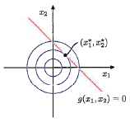
Solution is
x₁* = x₂* = ½
Solution is constrained to be on the red line x₁ + x₂ = 1
Blue circles are contours of f(x₁, x₂) = 1 - x₁² - x₂²

Slide 28
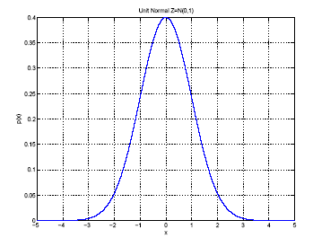
Similarly for Gaussian distribution in 1D
p(x) = N ( μ, σ²)
MLEs for μ and σ²:
μ
σ
Function of a single random
variable with a shape
characterized by 2 parameters
Lecture Notes for E Alpaydın 2010 Introduction to Machine Learning 2e © The MIT Press (V1.0)
28

Slide 29
Pseudo-code for sampling a Gaussian distribution with specified mean and variance
z is normally distributed with
zero mean and unit variance
Find a library function for random numbers drawn from p(z)
Given a random number z_{i} from this distribution,
x_{i} = σ z_{i} + μ is a random number with the desired characteristics

Slide 30
Multivariate Gaussian Distribution
Mean is vector with components that are the
mean each attribute
Variance is a matrix called “covariance”
Diagonal elements are σ² of individual attributes
Off diagonals describe how fluctuations in one
attribute affect fluctuations in another.
dxd
dx1
1xd
Lecture Notes for E Alpaydın 2010 Introduction to Machine Learning 2e © The MIT Press (V1.0)
30

Slide 31
dxd
dx1
1xd
Dividing off-diagonal elements by the product of variances,
gives “correlation coefficients”
Correlation among attributes makes it difficult to say how
any one attribute contributes to an effect.

Slide 32
Mahalanobis distance: (x – μ)^{T} ∑^{–1} (x – μ)
analogous to (x-μ)²/σ²
x - μ is a column vector
Σ is dxd matrix
M-distance is scalar
Measures distance of x
from mean in units of Σ
d denotes number of variables (attributes)

Slide 33
Naïve Bayes classification
Assumes that correlation coefficients are zero; hence, covariance matrix is diagonal.
Class likelihood, p(x|C), is a product of 1D Gaussians for each attribute.
Each class is characterized by a set of means and variances of the attributes of examples in the dataset that belong to that class.
33

Slide 34
Discriminants: functions in attribute space that guide class assignment
In Bayesian classification, discriminants, g_{i}(x), are technically P(C_{i}|x).
Since normalization is not required for classification, g_{i}(x) = p(x|C_{i})P(C_{i}).
Even though priors do not depend on x, they may determine which g_{i}(x) is largest.

Slide 35
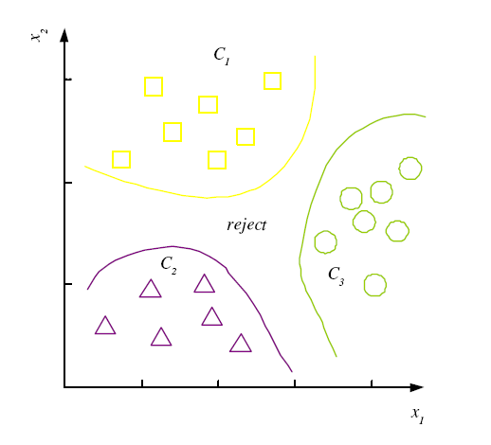
decision regions R₁,...,R_{K}
Non-disjoint decision regions in 2D
Usually decision regions are disjoint
Best illustrated in 1D
In 1D, boundaries of decision regions
called “decision points”.
Defined in binary classification by
g₁(x) = g₂(x)

Slide 36
In binary classification, g(x) = g₁(x) – g₂(x)
Is a useful combination of discriminants
If in addition, priors are equal and class likelihoods are Gaussian
is a useful combination of discriminants

Slide 37
1D binary Bayesian classification with Gaussian class likelihoods

Slide 38
Define a discriminant function using Bayes’ rule with class likelihoods that are Gaussian distributed
We can drop the term log(p(x)) Why?

Slide 39
Substitute the log of Gaussian class likelihood

Slide 40
Given a 1D multi-class dataset with Boolean class labels
and discriminant function
How do we use this discriminant to classify an object with attribute x?
Lecture Notes for E Alpaydın 2010 Introduction to Machine Learning 2e © The MIT Press (V1.0)
40

Slide 41
Given the value of attribute x, calculate g_{i}(x) for all of classes
Assign the object to the class with largest g_{i}(x)
Before this procedure can be followed, we must have
estimators for mean, variance, and prior of each class

Slide 42
Estimate prior, mean, and variance of all classes
x^{t} in 1D is a scalar, r^{t} is Boolean vector
Use r_{i}^{t} to pick out class i examples in sums over whole dataset
MLE of prior is the fraction of examples in class i
m_{i} and s_{i}² are class-specific estimators
Lecture Notes for E Alpaydın 2010 Introduction to Machine Learning 2e © The MIT Press (V1.0)
42

Slide 43
Use MLE results to construct class discriminants

Slide 44
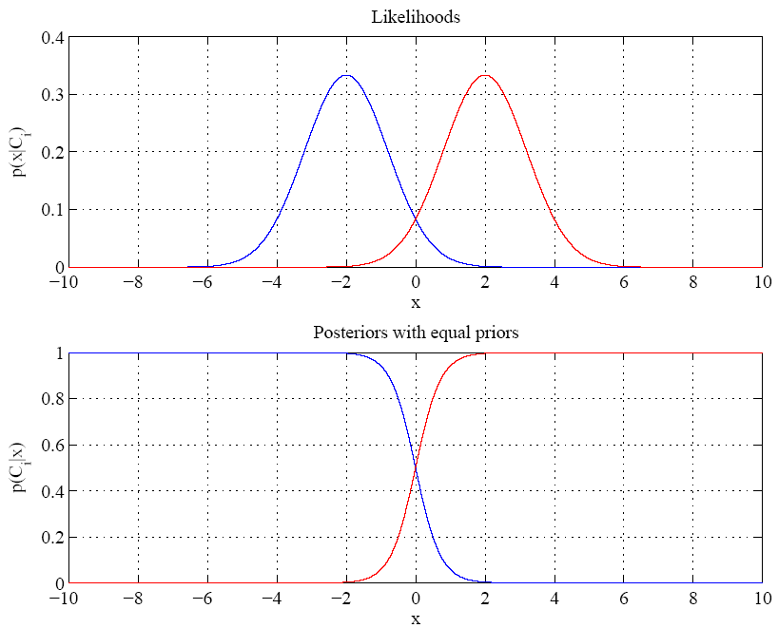
Example for
1D 2-class
problem
Equal variances
and priors
Between + 2
transition between
prediction of class
At boundary most probable class changes
Single boundary at
halfway between means where normalized posteriors are equal to 0.5
Decision regions are not disjoint.
Lecture Notes for E Alpaydın 2010 Introduction to Machine Learning 2e © The MIT Press (V1.0)
44
Notes:
Example: 2 classes
Class likelihoods have means + 2 and equal variance
Priors are also equal.
Between -2 and 2 have transition between essentially certain classification of classes as a function of x

Slide 45
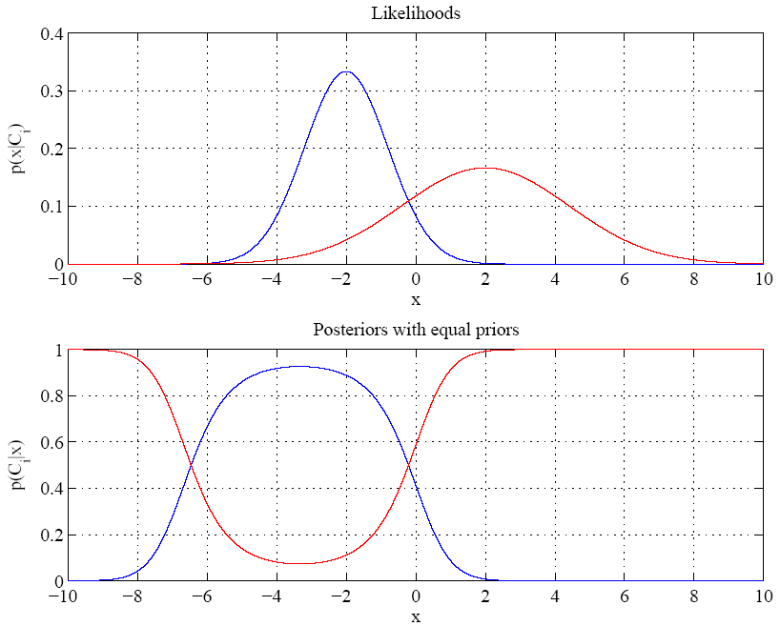
Red class likelihood
dominant for
x < about -7 also
Variances are different
Decision regions are disjoint
2 decision points
Lecture Notes for E Alpaydın 2010 Introduction to Machine Learning 2e © The MIT Press (V1.0)
45

Slide 46
Assignment 2: Due 9/1/16
Use the equality of discriminants to derive a quadratic equation for Bayes’
discriminant points in a 1D, 2-class problem with Gaussian class likelihoods
Mean and variance of C1 class likelihood are 3 and 1, respectively
Mean and variance of C2 class likelihood are 2 and 0.3, respectively
Assume priors are equal
With a sample size of 100, compare the MLE estimators to the true means
and variances.
For the same sample, compare Bayes’ discriminant points calculated from
MLE estimators with those derived from the true means and variances.

Slide 47
For a 1D, 2-class problem with Gaussian class likelihoods, derive the functional form of P(C1|x) when the following are true:
(1) variances and priors are equal,
(2) posteriors are normalized
Start with the ratio of posteriors to eliminate priors and evidence

Slide 48
With equal priors
P(C1|x)/P(C2|x) = p(x|C1)/p(x|C2) = f(x)
How do we derive f(x)?

Slide 49
Define f(x) = p(x|C1)/p(x|C2) = N(μ₁, σ₁)/N(μ₂, σ₂)
Assume σ₁ = σ₂ = σ
f(x) = exp(-(x - μ₁)²/2σ²)/exp(-(x - μ₂)²/2σ²)
combine exponentials and simplify

Slide 50
Why did the quadratic term cancel?
Given the function form of f(x) find the functional form of P(C1|x)

Slide 51
Use normalization to eliminate P(C2|x) = (1 - P(C1|x))
P(C1|x)/(1 - P(C1|x) = f(x); Solve for P(C1|x)
y = wx+w₀
P(C1|x) = sigmoid(y)
Decision region of class 1
y(x) > 0; P(C1|x)>0.5

Slide 52
P(C₁|x)= sigmoid(w^{T}x) transforms the output node when perceptron is used for classification. Assign output to C₁ if s > 0.5
y = wx + w₀ = w^{T}x
s
w₀
s = sigmoid(y)
w
1
x
Bias node
This approach to binary classification differs for Bayesian classification with Gaussian class likelihoods only in how the weights are optimized.
ANN uses back propagation. Bayesian classification uses MLE.

Slide 53
Bayesian decision theory

Slide 54
Risk analysis
Action α_{i} : assigning example x to C_{i} of K classes
Loss λ_{ik} occurs if we take α_{i} when x belongs to C_{k}
Expected risk (Duda and Hart, 1973)

Slide 55
Special case: correct decisions no loss and error have equal cost: “0/1 loss function”
For minimum risk, choose the most probable class

Slide 56
Add rejection option: don’t assign a class
1-λ is risk making some assignment
risk of no assignment
risk of choosing C_{i}
Lecture Notes for E Alpaydın 2010 Introduction to Machine Learning 2e © The MIT Press (V1.0)
56
Notes:
If the risk of making an assignment is low (large λ), then the threshold on max posterior for choosing that class is lower. We can make class assignments even when posteriors are not very discriminating (i.e. even when the classifier is weak). We use such a classifier when the risk associated with no decision is high.
If the risk of making an assignment is high (low λ), then we want a classifier that is very discriminating (i.e. generates a posterior for the correct class that are near unity)

Slide 57
Example of risk minimization with λ₁₁ = λ₂₂ = 0, λ₁₂ = 10, and λ₂₁ = 1
Loss λ_{ik} occurs if we take α_{i} when x belongs to C_{k}
R(α1|x) = λ₁₁ P(C1|x) + λ₁₂ P(C2|x) = 10 P(C2|x)
R(α2|x) = λ₂₁ P(C1|x) + λ₂₂ P(C2|x) = P(C1|x)
Choose C1 if R(α1|x) < R(α2|x), which is true if
10 P(C2|x) < P(C1|x), which becomes
P(C1|x) > 10/11 using normalization of posteriors
Consequence of erroneously assigning instance to C1 is so bad that
we choose C1 only when we are virtually certain it is correct.

Slide 59
Gaussian Parametric Classification
Define a discriminant function using Bayes’ rule with class likelihoods that are Gaussian distributed
prior
likelihood
posterior
evidence
First step: Take log of P(C|x)
59

Slide 60
Utility Theory
Prob of state k given exidence x: P (S_{k}|x)
Define “utility” of action α_{i} when state is k: denoted U_{ik}
Usually stated in monetary terms: gain/loss from right/wrong decision; cost of deferral to human expert
Expected utility:

Slide 61
Association Rules and Measures
Association rule: X → Y
People who buy/click/visit/enjoy X are also likely to buy/click/visit/enjoy Y.
A rule implies association, not necessarily causation
Support (X → Y): the joint probability
Statistical significance of rule

Slide 62
More association measures
Confidence (X → Y): the conditioned probability
Lift (X → Y): probability ratio
Strength of rule
>1 X makes Y more likely
<1 X makes Y less likely

Slide 63
Hidden variables may be the real cause of associations
“Baby at home” may be real cause of association
between baby food, diapers, and milk
Graphical methods (Baysian networks) let us
construct, visualize, and compute
associations evolving from hidden variables.

Slide 64
Review of Chapter 3
Probabilities
what is a joint probability distribution
what is a conditioned probability distribution
what is a marginal probability
Bayes’ rules
what is a prior
what is a class likelihood
what is a posterior
what is evidence
Lecture Notes for E Alpaydın 2010 Introduction to Machine Learning 2e © The MIT Press (V1.0)
64
Notes:
Evidence, p(x), is essentially a normalization; also called “marginal probability” that x is seen regardless of class

Slide 65
Review of Chapter 3
What are the properties of a strong Bayes classifier
with respect to posterior probabilities
with respect to rejection
example of when rejection needed in a classifier
Lecture Notes for E Alpaydın 2010 Introduction to Machine Learning 2e © The MIT Press (V1.0)
65

Slide 66
Risk analysis (Duda and Hart, 1973) slide 9
What is purpose of risk D&H risk analysis?
What is the 0/1 loss function?
How does 0/1 loss function lead to the rule “for min risk chose class with high posterior”?
How is rejection included in risk analysis?
How does large risk associated with rejection affect assignment of examples to classes?
What is the purpose of a cascade of classifiers?
How does the 0/1 loss function with rejection change in a cascade of classifiers
Lecture Notes for E Alpaydın 2010 Introduction to Machine Learning 2e © The MIT Press (V1.0)
66

Slide 67
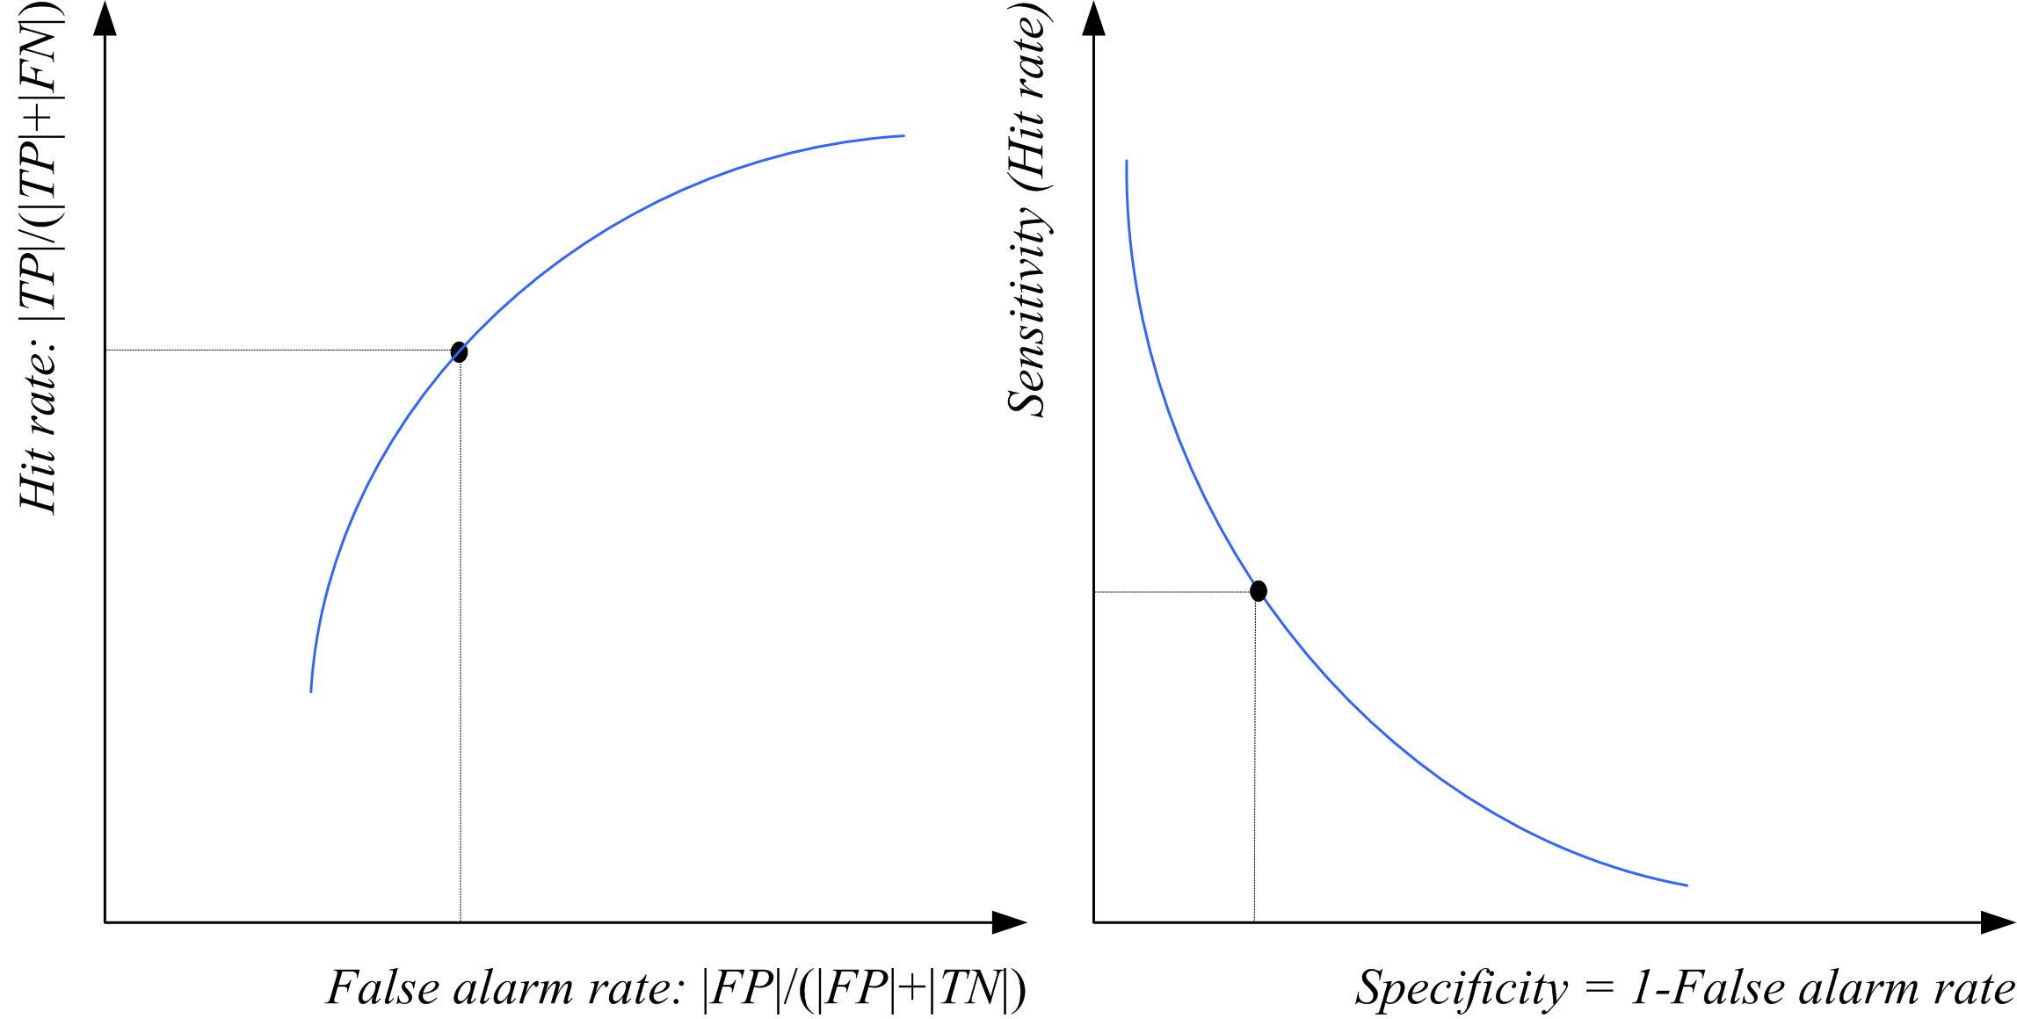
ROC-related Curve
Other combinations of
confusion-matrix variables
can be use in θ-parameter
curve definitions
Lecture Notes for E Alpaydın 2010 Introduction to Machine Learning 2e © The MIT Press (V1.0)
67

Slide 68
Statistical dichotomizer on 2 attributes
Credit scoring: Inputs are income and savings.
Output is low-risk vs high-risk
Input: x = [x₁,x₂]^{T} ,Output: C ∈ {0,1}; let 1 = high risk
Prediction:

Slide 69
Contrast between parametric and non-parametric methods
Parametric: use the discriminant function to assign class
Evaluate
Given estimators of mean and variance from MLE
All based on assumption of Gaussian class likelihoods

Slide 70
Contrast between parametric and non-parametric methods
Non-parametric: use the same discriminant function
with parameters determined from data
y = wx + w₀ = w^{T}x
s
w₀
s = sigmoid(y)
w
x
Some optimization procedure must replace MLE.
For ANNs we use back propagation most often

